Slide 1
End-to-End Pipeline of Public Housing Data in Singapore
Group 3:
Lee Chen Xi (A0220687B)
Kwong Wai Kit (A0214352R)
Su Zifeng (A0222369A)
Melvin Dio Haryadi (A0219799A)
Eugene Lim (A0217424L)

Slide 2
Presentation outline
INTRODUCTION
01
DATA SOURCES
02
03
SENTIMENT ANALYSIS
04
DASHBOARDS
Eugene
DATA PIPELINE
MACHINE LEARNING
05
06

Slide 3

Introduction
Eugene
Background
Objective
Aggregate and analyze data from various sources
Derive meaningful insights and forecast housing prices
Help potential homeowners make better data-driven decisions in their purchases
HDB is the sole provider for public housing in Singapore, it aims to provide affordable housing options for Singaporean
About 80% of Singaporeans live in public housing
Many considerations for homebuyers – price appreciation of property, location, flat size, budget etc.
Hard to find a user-friendly platform that encompasses current and historical housing data

Slide 4



DATA SOURCES
HDB Resale Transactions dataset
Yahoo Finance Dataset
Reddit comments on HDB prices
BTO (Build-To-Order) Price ranges dataset
Eugene

Slide 5
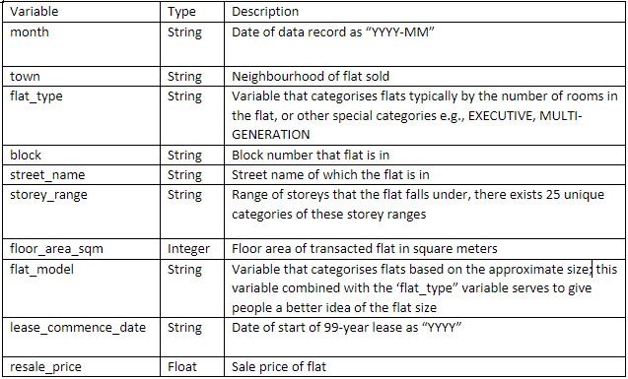
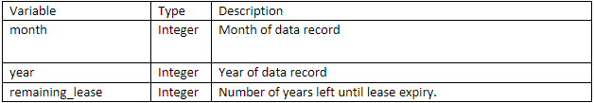
DATA PRE-PROCESSING
HDB Resale Transactions dataset
Eugene
PRE-PROCESSING
Separated month column with the format "YYYY-MM" into 2 separate columns month and year
Created additional column "remaining lease", derived from the lease commencement date and transaction year
New variables:

Slide 6
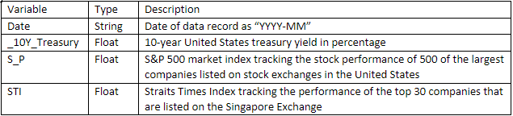
DATA PRE-PROCESSING
Yahoo Finance Dataset
Eugene
PRE-PROCESSING
Kept only Adjusted Close Price for 10Y Treasury Rates (^TNX), Straits Times (^GSPC) and S&P500 Index (^STI)
For historical data, we kept the last data point of every month to be aligned with the labelling of the Resale Transaction Data.
For the current month, we use the latest available data point which would be updated every day.

Slide 7
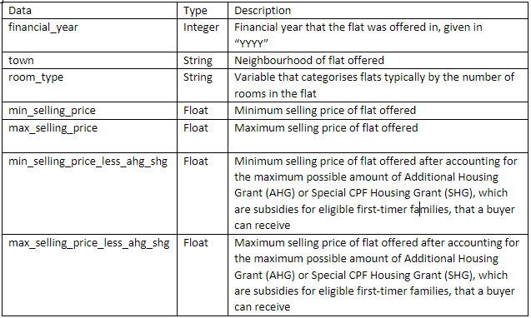
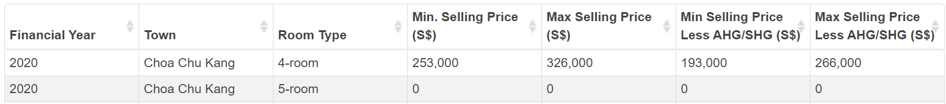
DATA PRE-PROCESSING
BTO (Build-To-Order) Price ranges dataset
Eugene
PRE-PROCESSING
Removed rows where data was $0 for all price columns

Slide 8
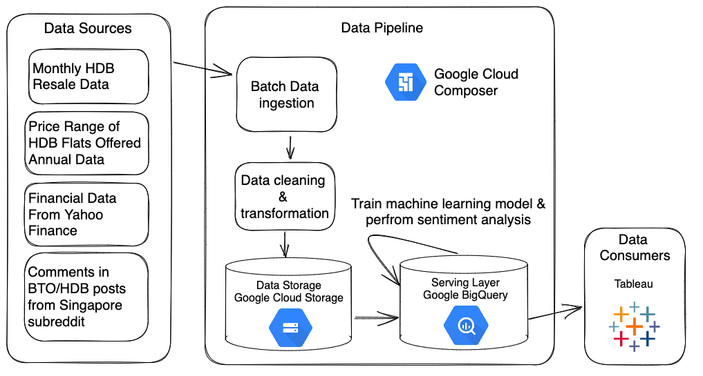
DATA PIPELINE
Wai Kit
Notes:
From the data sources, our data pipeline ingests data in batches and performs data cleaning & transformation. The data is then stored in Google Cloud Storage which feeds data to BigQuery, our serving layer, to train our machine learning model, perform sentiment analysis, and execute queries from our downstream Tableau data analytics client.

Slide 9


DATA PIPELINE
Wai Kit
Using Google Cloud Platform & Tableau
Factors considered: scalability, integration, cost
BigQuery, Google Cloud Storage & Google Cloud Composer
Scalable, integrated services
Feature-rich
Notes:
For our data pipeline, we have chosen to use the Google Cloud Platform and its services, and Tableau for data analytics. We made the choice after considering factors such as scalability, integration, and cost. Google Cloud Platform is scalable and its services are well integrated to many different platforms, including those used in this project. It easily enables remote collaboration on the same instance, and the overall cost is low with credits for a trial. Tableau is used instead of Looker Studio from Google as it provides a much richer feature set.

Slide 10



GCP SERVICES
Google Cloud Composer
Google Cloud Storage
Google BigQuery
Wai Kit
Orchestration
Managed Airflow environment integrated with other Google services
Data storage
Performant, scalable, integrated cloud storage solution
Serving Layer
NoSQL database with built-in machine learning & compatibility with Tableau
Notes:
The services used are as follows. Google Cloud Composer is used to orchestrate the different systems in our data pipeline. It is a managed Apache Airflow environment that has integrations with other Google services. For data storage, Google Cloud Storage is performant, scalable, and integrated with BigQuery, making it our solution of choice. BigQuery is used as the serving layer to execute queries from downstream clients on the data. Its NoSQL architecture and built-in machine learning is well-suited to our needs and is compatible with a Tableau client.

Slide 11
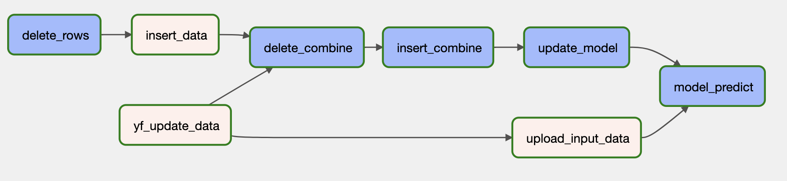
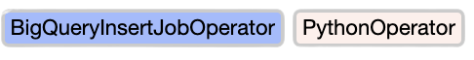
RESALE & FINANCIAL DATA WORKFLOW
Wai Kit
1
Delete existing records for current month and year
2
Ingest resale & financial data
3
Transform and combine data, then insert into BigQuery
4
Train model with updated dataset
5
Make predictions for predefined parameters and write into BigQuery
Execution interval: 1 day
Notes:
We have a total of 3 workflows in our data pipeline. First is the resale & financial data workflow. It will delete existing records for the current month & year, ingest new resale & financial data, transform and combine them, then insert the result into BigQuery. After that, it will train our ML model with the updated dataset, make predictions for predefined parameters, and write it into BigQuery. This workflow is executed on a daily basis.

Slide 12
DELETION & INSERTION
Wai Kit
Resale Data
Financial Data
To ensure that there are no duplicates due to the ordering of data
For an instance, a new sale in Ang Mo Kio is added not at the back of the ordering in the API but clustered together with the rest of the Ang Mo Kio transactions in 2023
Lack of a primary key to uniquely identify transactions
Unable to match new records against existing ones
To retain only the last adjusted close price/value
Align with the month-level labelling of resale data
Solution
Delete all data for the latest year/month dynamically, then query latest data from API to update table​
Notes:
We perform some deletion at the beginning due to the nature of our data & data sources. The aim regarding the resale data is to ensure that there are no duplicated records due to the ordering of data. For an instance, a new sale in Ang Mo Kio is added not at the back of the ordering in the API but clustered together with the rest of the Ang Mo Kio transactions in 2023. As there is a lack of a primary key to uniquely identify transactions, we are unable to match new records against existing ones. For the financial data, we want to retain only the last adjusted close price to align with the month-level labelling of resale data. Therefore, the solution to both of these problems is to delete all data for the latest year/month dynamically, then query latest data from API to update table.

Slide 13
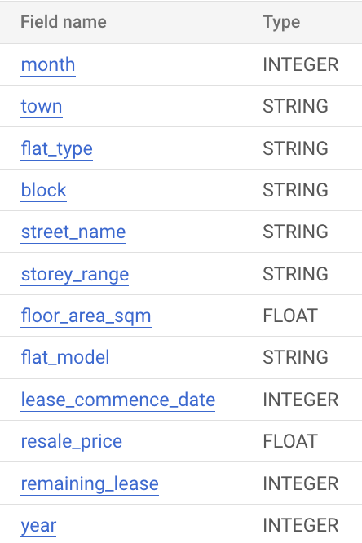
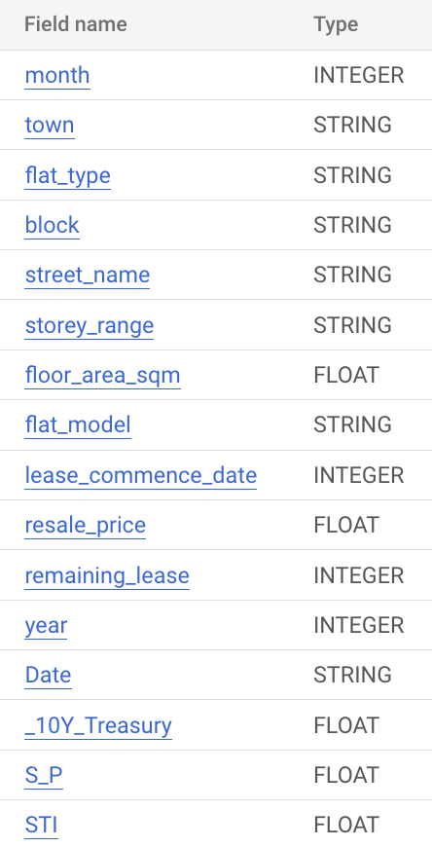
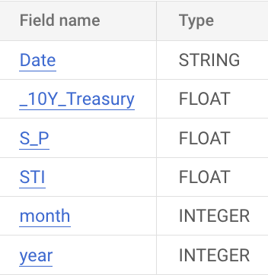






COMBINING DATA
Wai Kit
Join resale transactions with the respective financial data into a single record using month & year
Resale
Financial
Notes:
To combine the data from the two sources, we join the resale transactions with the respective financial data into a single record using month & year to create a combined dataset.

Slide 14
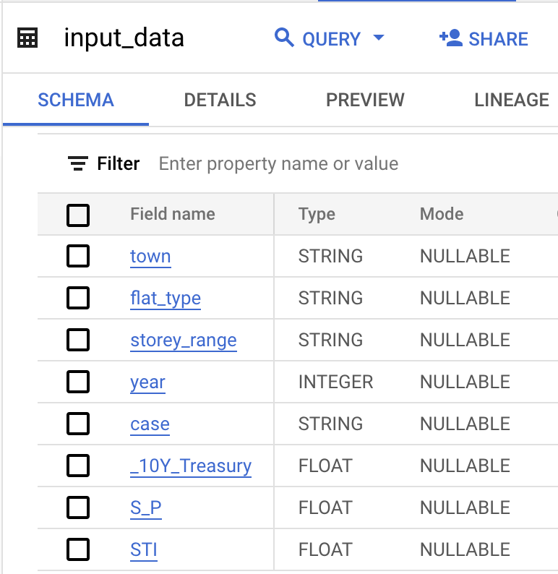
TRAINING & PREDICTION
Wai Kit
Once we have the combined data, selected features are written to a table for training of our machine learning model
Dependent on the combined data since features come from both the resale & financial data
Predictions are then made for predefined parameters and written into BigQuery
Notes:
Once we have the combined data, selected features are written to a table for training of our machine learning model. This part of the workflow is dependent on the combined data since features come from both the resale & financial data. Predictions are then made for predefined parameters and written into BigQuery.

Slide 15
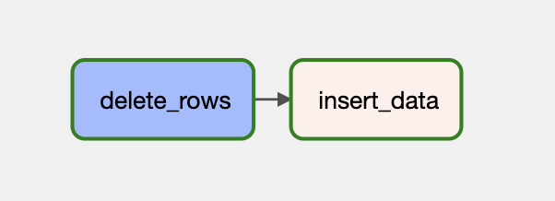
BTO DATA WORKFLOW
Dio
1
Delete existing BTO records
2
Transform and insert new data
Execution interval: 1 month

Slide 16
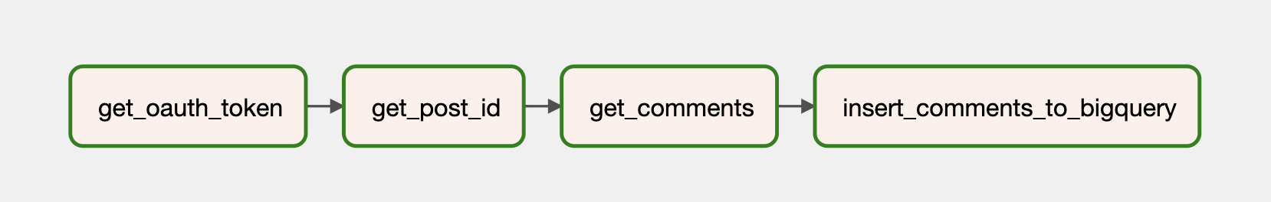
REDDIT DATA
Dio
1
2
Get list of post IDs via a search query
Authenticate and obtain token
Perform sentiment analysis and write comments & their scores to BigQuery
3
Get list of comments for each post ID
4
Execution interval: 1 day

Slide 17

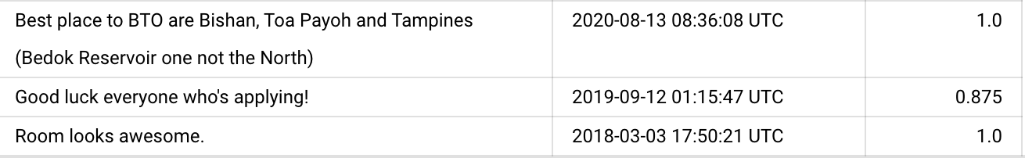


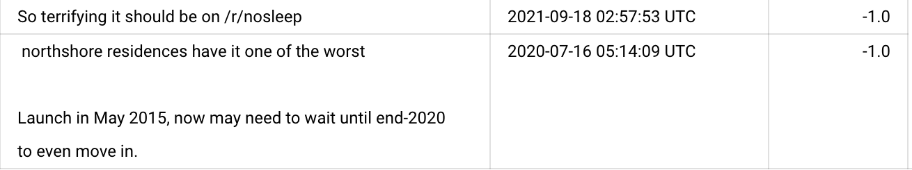
Dio
SENTIMENT ANALYSIS
Why TextBlob?
Example Results for Polarity Scoring
Positive Polarity Scores:
TextBlob has a prebuilt sentiment analysis model trained on a large corpus of data, making it highly reliable in terms of prediction.
It has an intuitive and easy to understand API, while maintaining good predictive power.
TextBlob accepts raw text directly and performs text preprocessing steps such as tokenization and sentence segmentation automatically.
comment_text
date
polarity_score
Negative Polarity Scores:
comment_text
date
polarity_score
Notes:
Foreign buyers

Slide 18
MACHINE LEARNING
Zifeng
01
Model Creation
Feature Selection, Data Split, Hyperparameter Tuning
02
Model Evaluation
Accuracy, Speed, Computational Cost
03
Model Prediction
Prediction Query, Prediction Results
Notes:
Our objective for machine learning is to predict future resale price trends across time, economic environments and across categories of housing such as town and storey range. There are 3 steps to the prediction process, including model creation, model evaluation and model prediction.

Slide 19
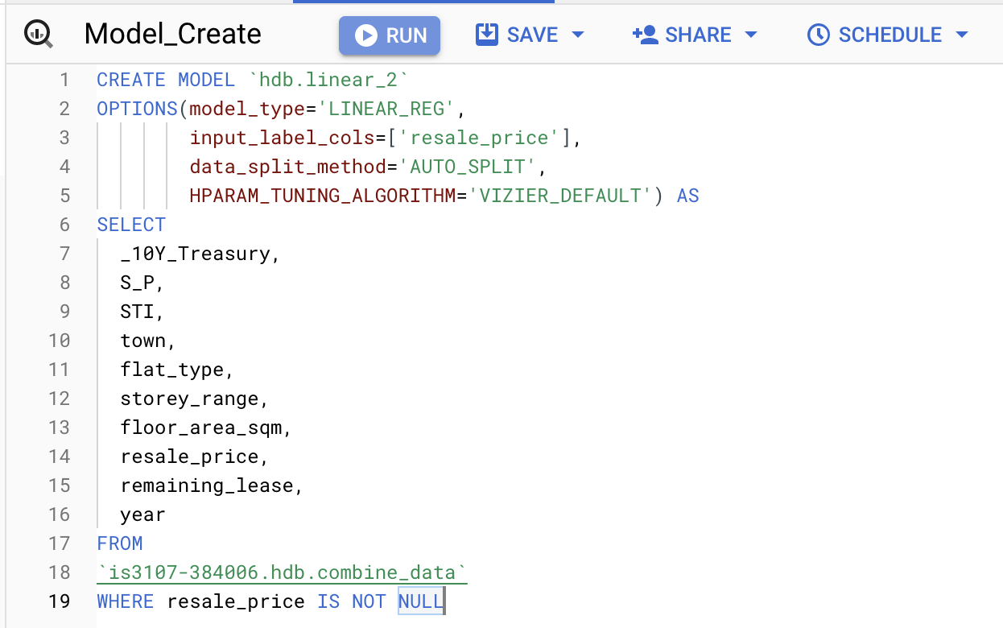
MODEL CREATION
Zifeng
Model Selection
Linear Regression, Random Forest, Boosted Trees and more
Data Split
Auto, Random, Sequential, Custom, None
Hyperparameter Tuning
Google Vizier, Random search, Grid Search
Feature Selection
Removed features that were not interpretable in visualization
Block number, Street name and more
Notes:
The image on the left shows the model creation query in BigQuery. This query is triggered manually in the BigQuery UI for model evaluation purposes and automatically triggered as part of the DAG using Google Cloud Composer.
First, we must define the model type for Machine Learning. BigQuery ML provides several machine learning models for regression, including linear regression, random forest, boosted trees, deep neural network, and Auto ML. All the available models are evaluated, except for Auto ML, due to the extremely long training time of over 2 hours.
Next, we define the train-test split using the data split method. Auto Split refers to a random split of 10,000 records for evaluation and the rest for training, given that we have more than 50,000 records in our dataset. While we considered a commonly used 80-20 randomized split, we ultimately elected to limit the number of records for evaluation to minimise overfitting.
For the hyperparameter tuning algorithm, we relied on Google's Vertex AI Vizier, which uses a combination of advanced search algorithms such as Bayesian Optimisation with Gaussian Process. While options like random search and grid search were available, we observed substantially reduced model training times and better performance for the Vizier algorithm.
Finally, we selected most of the features available, but removed some features that were not as interpretable during prediction. For instance, block number and street number are too specific for potential buyers.

Slide 20
Zifeng
MODEL EVALUATION
Speed
Accuracy
Cost
Model Type | Training Time | R^2 | Explained Variance | Processed Bytes
Linear | 2 min | 0.733 | 0.726 | 67.01MB
Boosted Trees | 10 min | 0.782 | 0.829 | 32.82GB
Random Forest | 10 min | 0.791 | 0.818 | 32.82GB
DNN | 10 min | 0.475 | 0.371 | 16.59GB
DNN + Linear | 10 min | 0.463 | 0.380 | 16.64GB
Notes:
We evaluate the models along three dimensions: speed, accuracy and computational cost. To compare the performance of the various models, we trained our models on data up to 2022, using the past 6 months as the validation set.
In terms of accuracy, boosted trees and random forest perform the best, followed by linear regression. However, due to the simplicity of the linear model, the training time and computation costs are far superior to any of the other models. In addition, linear regression provides a clear and interpretable relationship between housing features such as the town against resale price which can be easily evaluated when performing sanity checks of the model. We believe that the slight reduction in accuracy is a worthwhile trade-off for speed, cost, and interpretability.

Slide 21
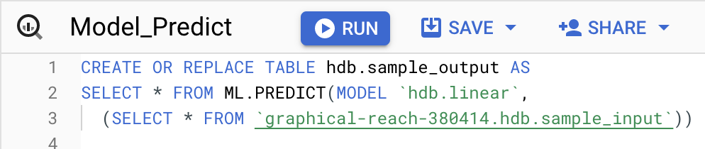
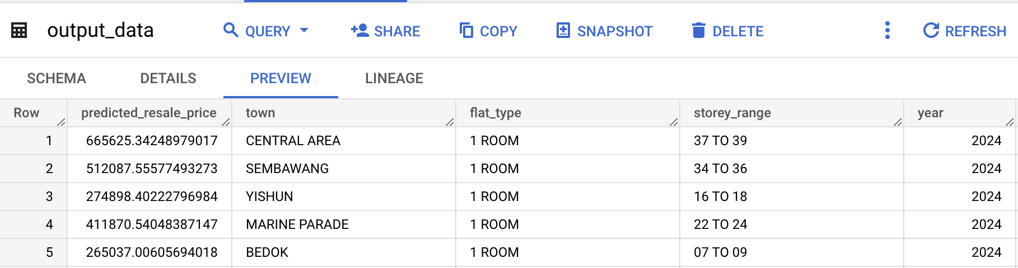
Zifeng
MODEL PREDICTION
Prediction Query
Takes in input features for future data across economic regimes
Generates predicted resale price using trained linear regression model
Notes:
For model prediction, we predict the resale prices using the table of features generated earlier and the newly trained linear regression model. The input data is similar to the output data as shown, except without the predicted resale price. As we can see, each row varies in terms of the features used such as town and storey range, resulting in different predicted prices.
These predicted outputs are stored in BigQuery, which is accessed by Tableau to generate the predicted price analysis dashboard that Chen Xi will share more about later.

Slide 22
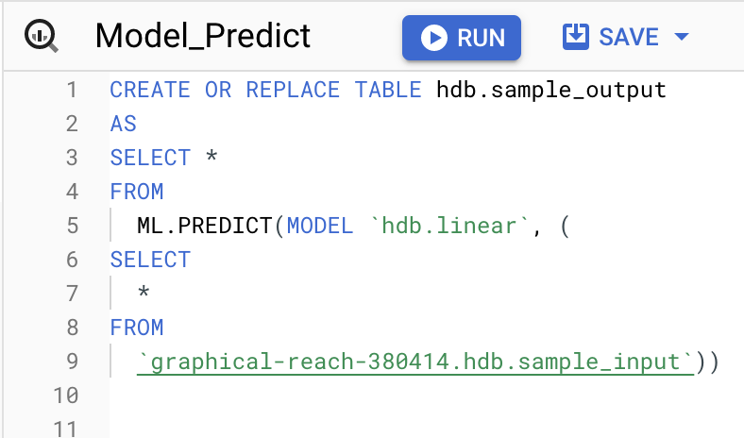
Zifeng
MODEL PREDICTION
1. Feature Generation
2. Price Prediction

Slide 23


Chen Xi
END USERS
End User
Home Buyers
Property Agents
Objective
Purchase a property that meets their housing / investment needs and fits within their budget
Help clients buy and sell properties in a timely and efficient manner
Needs
Comprehensive information on trends in the local real estate market
Knowledge on the economic climate and financing costs environments
Tools to better engage clients with the use of data analysis and visualizations on updated information
Notes:
Foreign buyers

Slide 24
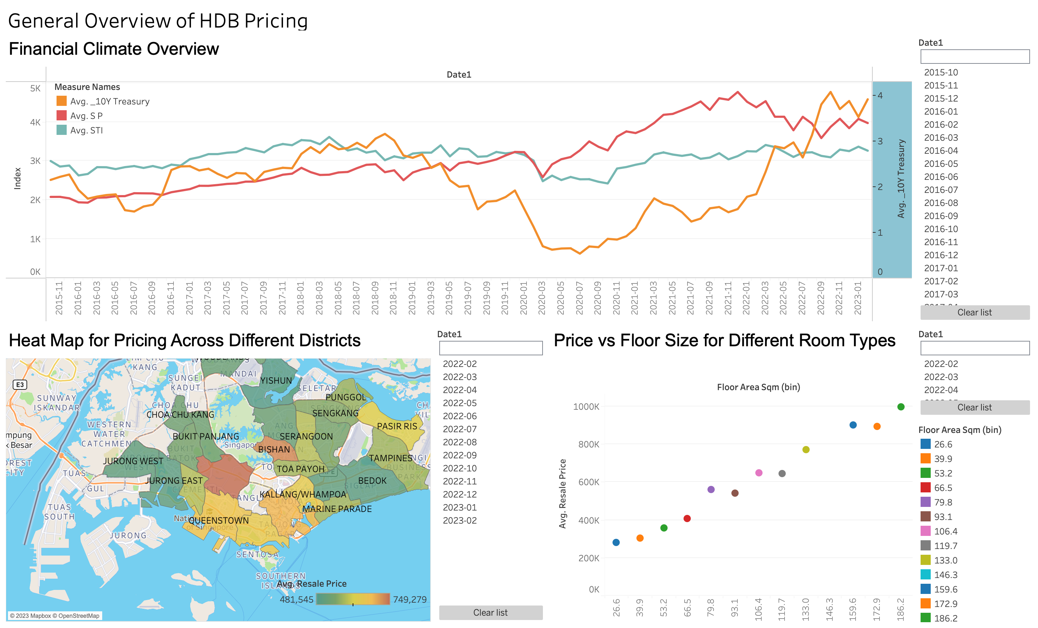
DASHBOARD 1: General Overview of HDB Pricing
1
Line Graph of US Treasury, S&P500
and SPX Index
Provide color on general economic sentiment which affects ability to finance property purchase
Current high interest rates indicate bearish sentiments, so it may be worthwhile to hold off purchase
2
Heat Map for Pricing Across Districts
Color coding of average resale prices to facilitate users to determine suitable property location
Property in central districts are associated with higher prices than outskirts due to higher desirability, but Pasir Ris seems to be an anomaly
Notes:
Foreign buyers

Slide 25
DASHBOARD 1: General Overview of HDB Pricing
3
Scatter Plot of Average Resale Prices Across Floor Area
Evaluate relationship between resale prices and floor sizes
Larger floor sizes are associated with higher prices
Increase in prices is more significant between 70 – 80sqm compared to other 10sqm increments
Notes:
Foreign buyers

Slide 26
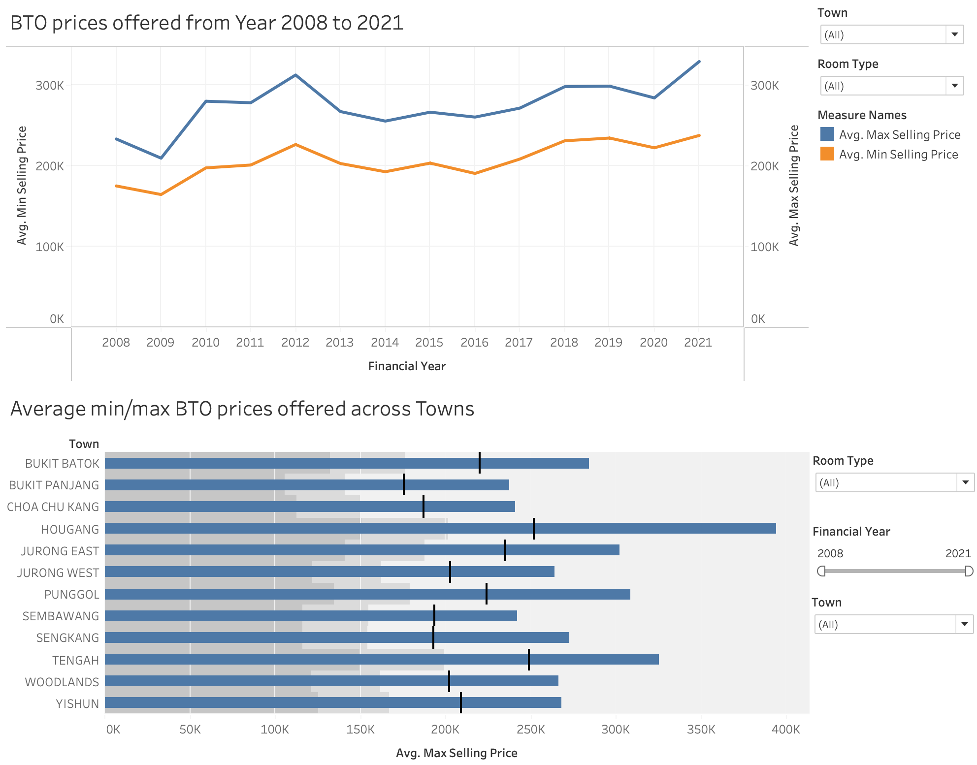
Chen Xi
DASHBOARD 2: BTO Pricing as Reference for Resale Prices
1
Historical Trend of BTO Prices
Min and Max selling prices of historical BTO
Serve as reference point to access relative value of resale flats
General uptrend in BTO prices due to land scarcity and increased demand
Sharp increase in maximum selling price from 2020 to 2021 likely due to pent-up demand
2
Horizontal Bar Graph of Max and Min Price Variations
Access range of relative prices for each town
3
Filters
Specify Town, Flat Type, Financial Year to better adjust analysis to user’s needs
Notes:
Foreign buyers

Slide 27
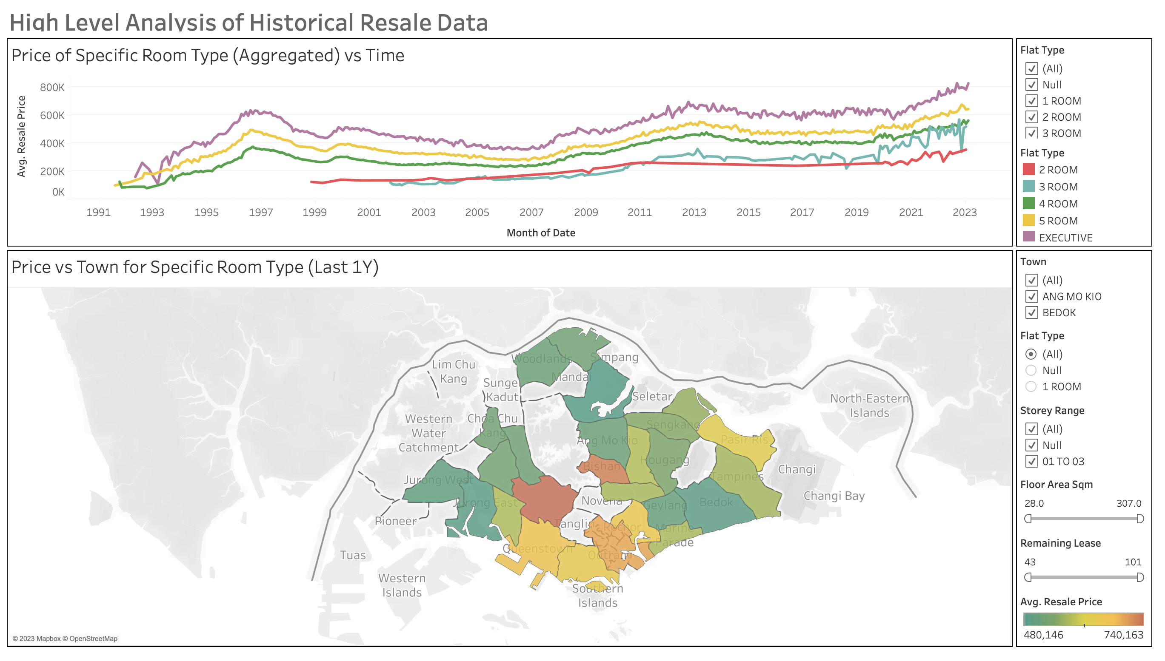
Chen Xi
DASHBOARD 3: High Level Analysis of Historical Resale Data
1
Multi-Series Line Chart of Resale Prices For Specific Room Types
Better determine suitable flat type that meets their budget range
High volatility of 3-room flats indicating that time of purchase may be more important
2
Heat Map for Specific Room Type in Each Town
Better determine location to purchase the property of a specific flat type that meets their budget range
3
Filters
Specify Town, Flat Type, Storey Range, Floor Area Range and Remaining Lease to better adjust analysis to user’s needs
Notes:
Foreign buyers

Slide 28
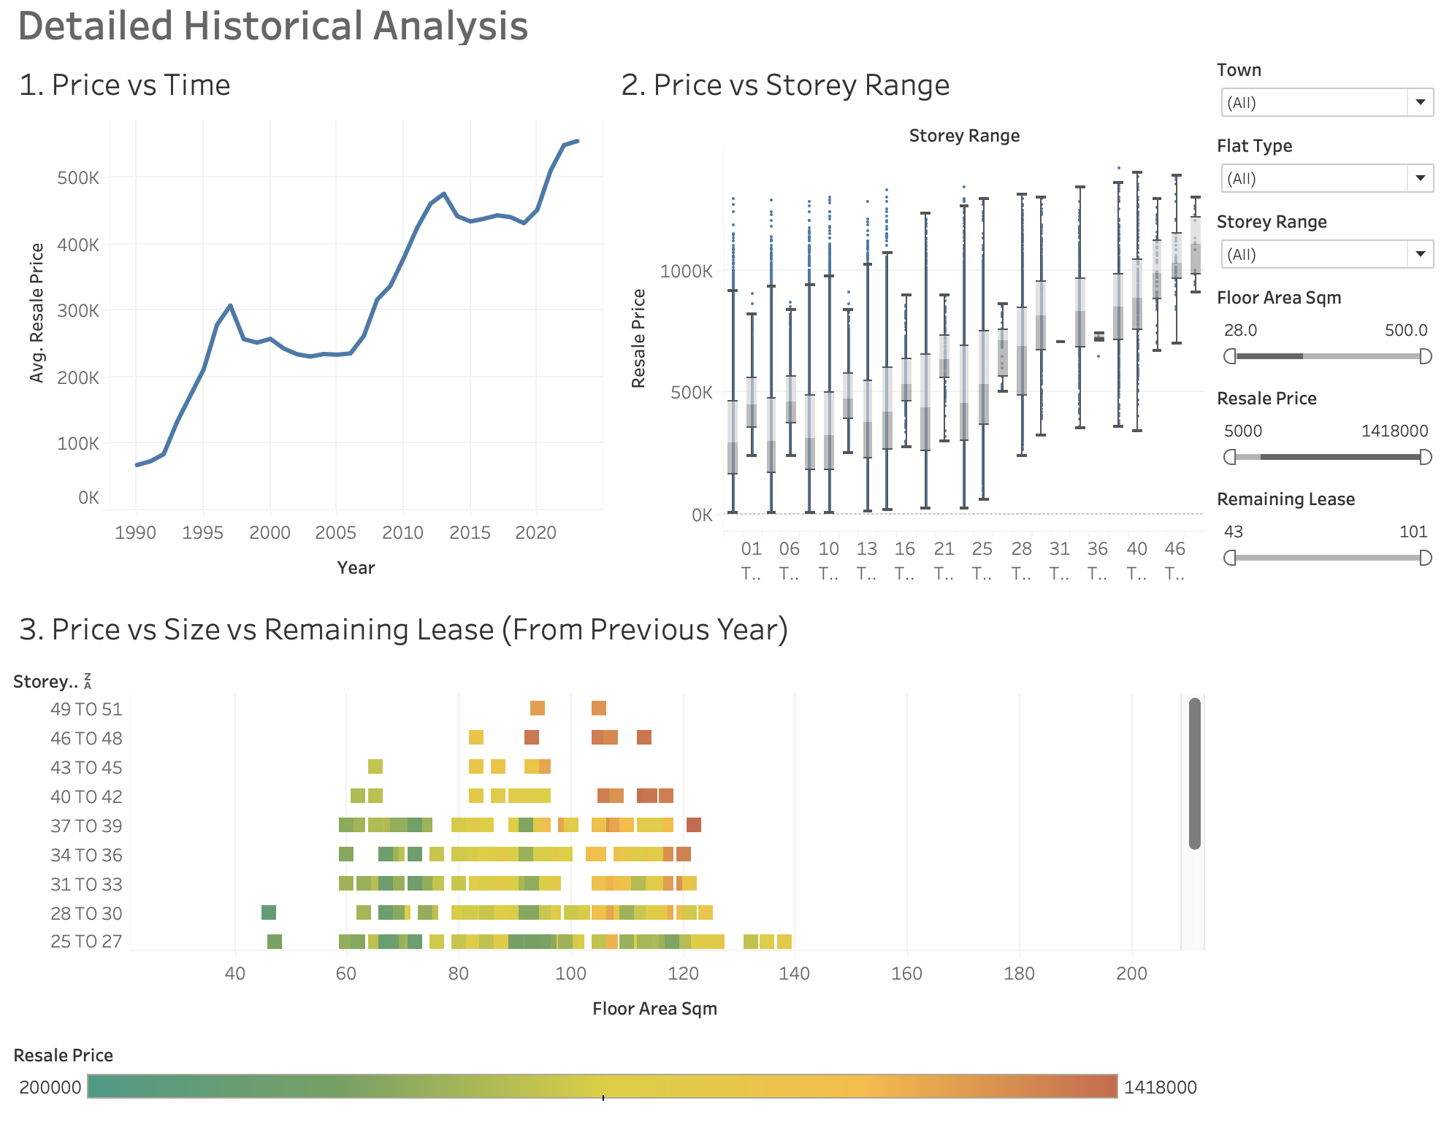
Chen Xi
DASHBOARD 4: Detailed Historical Analysis for Resale Data
1
Line Chart of Historical Resale Price Across Time
2
Boxplot of Historical Resale Price Against Storey Range
3
Colored Scatter Plot of Resale Prices Against Size and Remaining Lease
Notes:
Foreign buyers

Slide 29
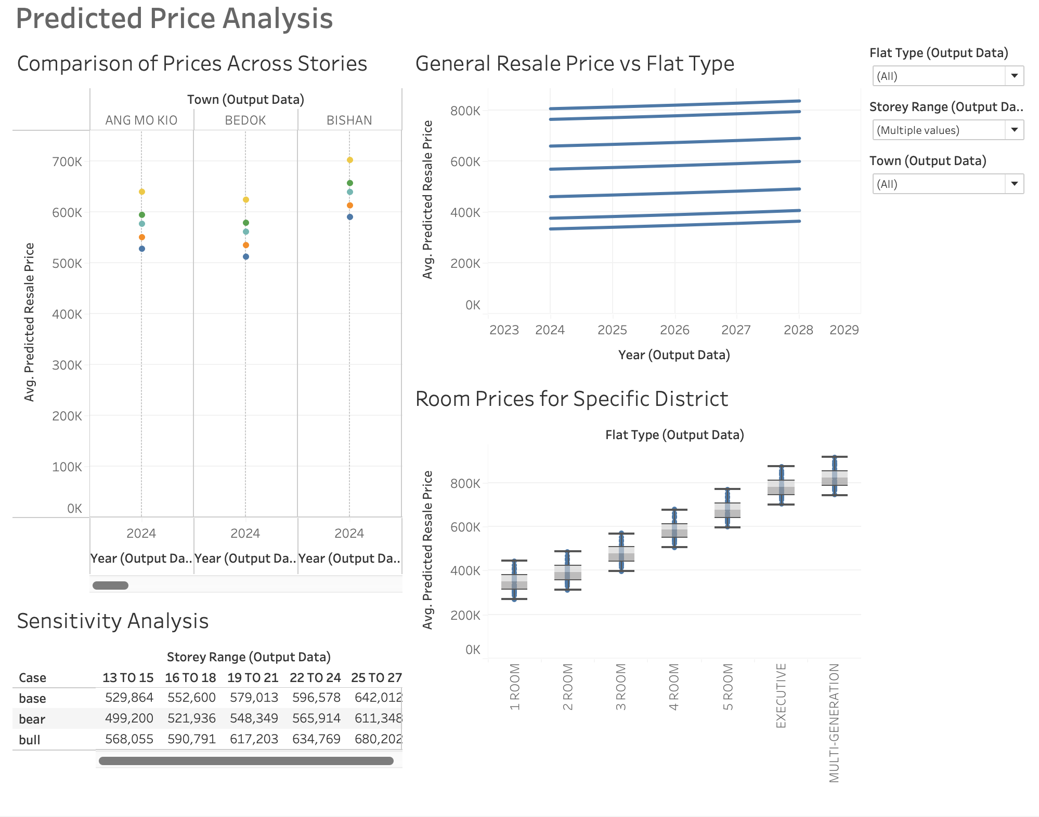
Chen Xi
DASHBOARD 5: Predicted Price Analysis
1
Dot Plot of Resale Prices of Each Flat Type Across Different Towns
HDB in Bedok within the 25 to 27 storey range is equivalent or slightly more expensive than that of a HDB in Bishan within the 16 to 18 storey range
2
Multi-Series Line Graph of Resale Prices of Each Flat Type
3
Boxplot to Showcase Variance of Predicted Prices Across Districts
4
Sensitivity Table for Different Economic Scenarios (Bear, Base, Bull)
Notes:
Foreign buyers

Slide 30
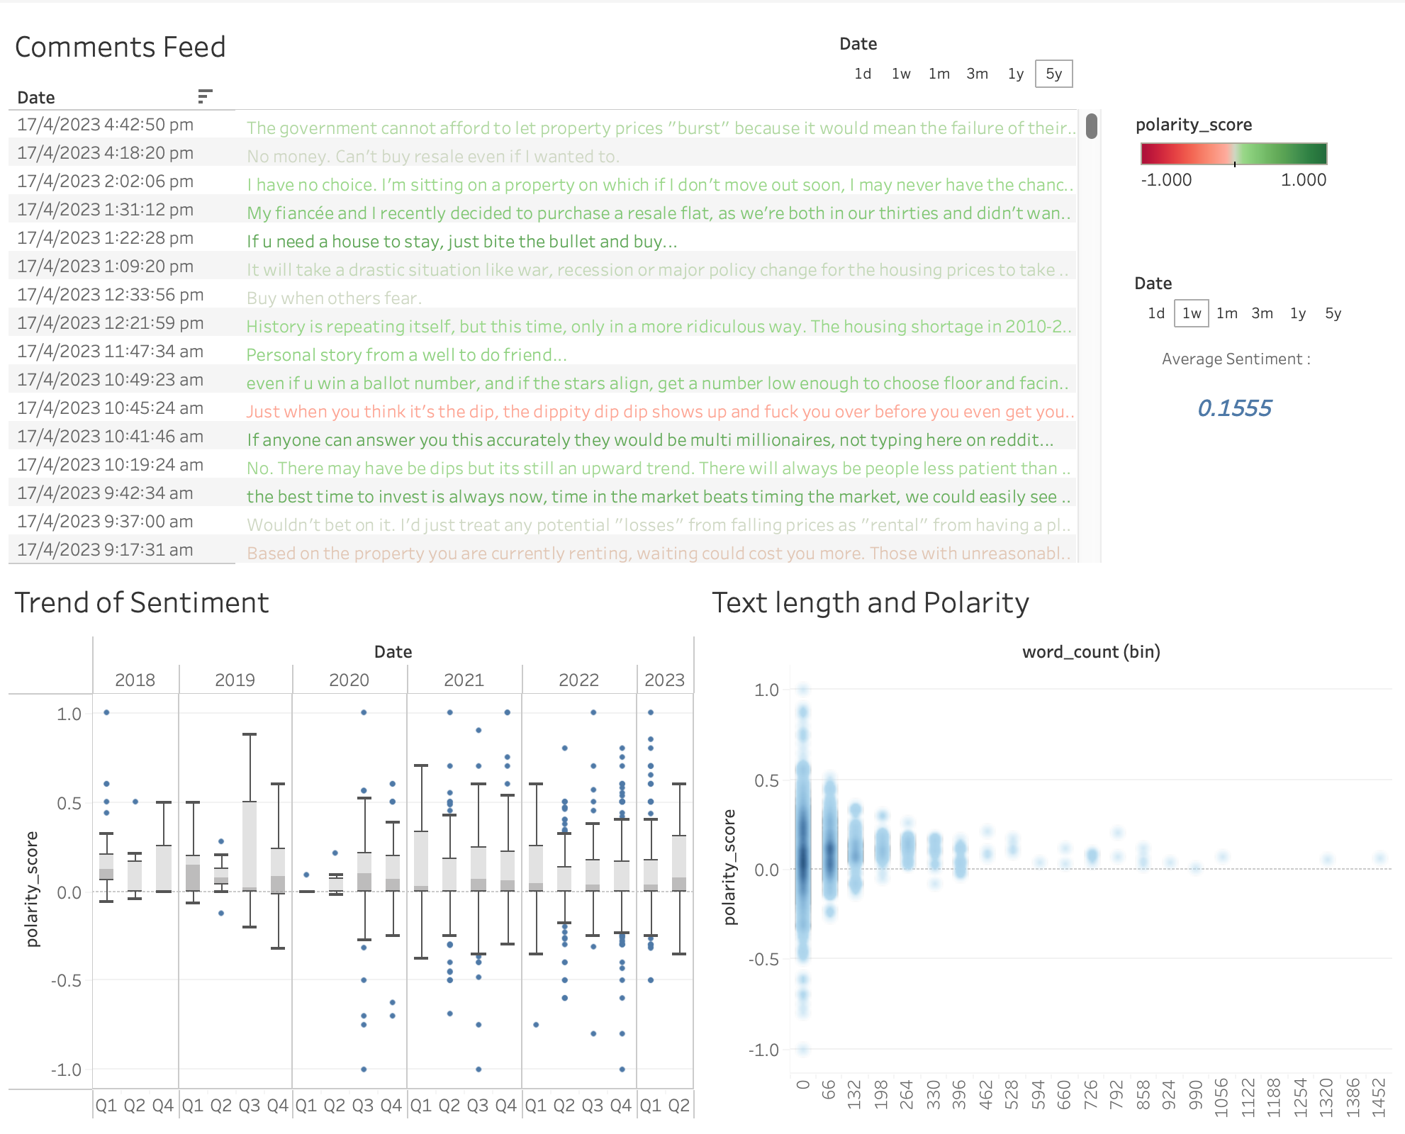
Chen Xi
DASHBOARD 6: Reddit Sentiment Analysis
1
Comments Feed filtered by Period
The comments are coloured based on the polarity score with the average score displayed in right hand side. From observing the average polarity among the different periods, recent comments has more positive sentiment than older ones.
2
Boxplot of Polarity Score for each Period
3
Density plot of Text Length and Polarity Score
Notes:
Foreign buyers

Slide 31

THANK YOU
Please keep this slide for attribution.

Slide 32


